Slide 1
Arista Programmability
eAPI | EosSdk | Python | PowerShell | C++

Slide 2
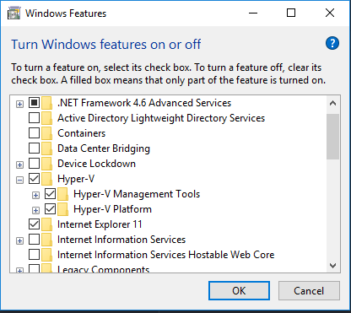
Setup
Base installation steps
Enable Hyper-V
Download and install Docker
https://www.docker.com/products/docker#/windows
Download and Install GitHub for Windows ( optional )
Browse to:
https://github.com/arista-northwest/arista-programmability
Click Clone download and select “Open in Desktop”
Or … “Download ZIP”

Slide 3
Docker build and run
Download the EosSdk-stubs to the project folder (link will be provided)
Build the Container
PS> cd <path-to-projects>/arista-programmability
PS> docker build -t ubuntu:arista-prog .
Run and Connect
PS> docker run -it -v <path-to-projects>/arista-programmability:/opt/arista-prog `
ubuntu:arista-prog
What does this do?
“-it” runs the container interactively and allocates a tty (runs a shell)
“-v <loca-path>:<container-path>” mounts the specified directory inside the container
“ubuntu:arista-prog” is the tag (name) given at build time

Slide 4
vEOS + HyperV: A Love Story
I’ve bundled the PDF with this project…
Here’s the short version:
Download a vEOS-lab vmdk (please use 4.17.1.1F for this lab)
Use Mvmc to convert to VHD
Create VM
In settings:
Delete SCSI and Network controllers
Add Aboot as a CDROM
Add legacy networking controllers

Slide 5
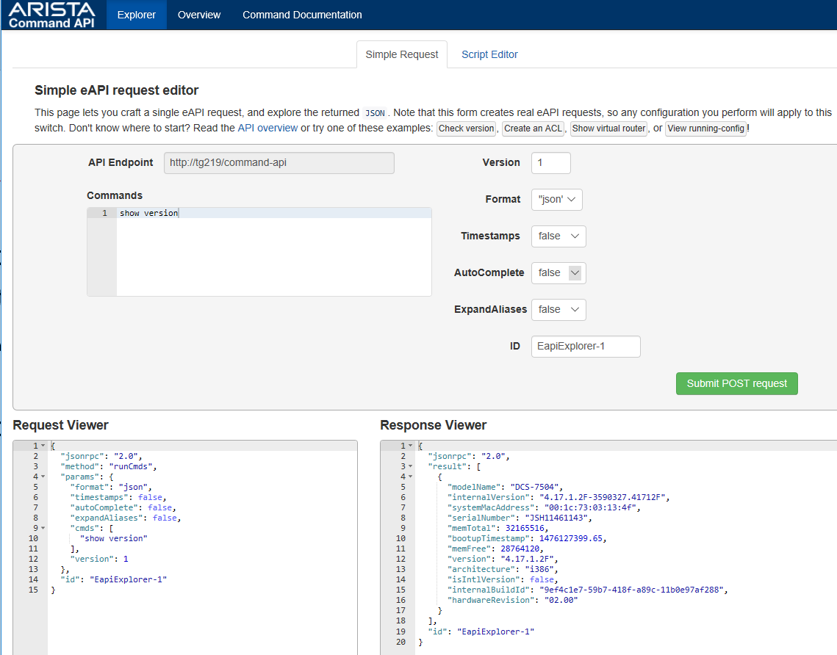
eAPI: Basic Operation
Step 1: Enable eAPI + Bonus (in)security settings
Step 2: Verify on-switch @ http://<switch-addr>/explorer.html
aaa authorization exec default local
aaa authentication policy local allow-nopassword-remote-login
!
username admin privilege 15 role network-admin
!
management api http-commands
protocol http
no shutdown

Slide 6
eAPI: Switch Based Script Editor
Edit JavaScript inline
Fully functional
Provide more advanced playground for testing with eAPI
Good reference if you know JavaScript
Further reading: http://<switch-addr>/main.js

Slide 7
eAPI: Basic Python Usage
NO additional libraries are required!
endpoint ="http://{}/command-api".format(switch_addr)
payload = magic_payload_constructing_function(commands)
headers = {"Content-Type": "application/json"}
creds = (username, password)
req = urllib2.Request(endpoint)
req.add_header("Content-Type",)
password_manager = urllib2.HTTPPasswordMgrWithDefaultRealm()
password_manager.add_password(None, endpoint, creds[0], creds[1])
auth_manager = urllib2.HTTPBasicAuthHandler(password_manager)
opener = urllib2.build_opener(auth_manager)
urllib2.install_opener(opener)
handler = urllib2.urlopen(req, data=payload)
See how easy that was!

Slide 8
eAPI: Basic Python Usage (Second try)
Install required additional libraries: requests (or jsonrpclib)
endpoint = "http://{}/command-api".format(switch_addr)
payload = magic_payload_constructing_function(commands)
headers = {"Content-Type": "application/json"}
creds = (username, password)
# now make the request.
requests.post(endpoint,
auth=creds, headers=headers, data=payload)
Take away: don’t bother with urllib2 – use a wrapper like ‘requests’

Slide 9
eAPI: Neat Tricks
Escape the CLI (Bash commands are supported)
Caveat: you must specify a timeout
commands = ["show version", "bash timeout 30 uname -a"]
Supply input for prompted commands
commands = [{"cmd": "enable", "input": "s3cr3t"},
"show running-config"]

Slide 10
Handling eAPI Responses
All eAPI responses are JSON formatted
{
"id": "AristaProgrammability-1",
"jsonrpc": "2.0",
"result": [
{
"fqdn": "localhost",
"hostname": "localhost"
}
]
}
Python handling code
print "The system hostname is:", response["result"][0]["hostname"]

Slide 11



eAPI: Dealing with problems…
Traceback (most recent call last):
File "eapi_client.py", line 372, in <module>
main()
File "eapi_client.py", line 356, in main
response = client.send(commands)
File "eapi_client.py", line 290, in send
return response["result"]
KeyError: 'result'
Traceback (most recent call last):
File "eapi_client.py", line 372, in <module>
main()
File "eapi_client.py", line 356, in main
response = client.send(commands)
File "eapi_client.py", line 288, in send
raise EapiException(response["error"]["message"])
__main__.EapiException: CLI command 1 of 1 'show venison' failed: invalid command

Slide 12
eAPI: Handling Errors
{
"id": "AristaProgrammability-1",
"jsonrpc": "2.0"
"error": {
"code": 1003,
"data": [
{
"errors": [
"Command cannot be used over the API at this time. \
To see ASCII output, set format='text' in your request"
]
}
],
"message": "CLI command 1 of 1 'show clock' failed: unconverted command"
},
}
Python handling sudo-code
if "error" in response:
# … evasive action …

Slide 13
eAPI: Raising and Catching Exceptions
Continuing from previous slide… Here’s a complete error handler example
class EapiException(Exception):
"""This class definition only purpose is to give the exception a name"""
pass
def send_commands(client, commands):
response = do_eapi_stuff()
if "error" in response:
raise EapiException(response["error"]["message"])
try:
response = send_commands(client, bogus_commands)
# we will never get here if the commands are indeed bogus
print "RESPONSE_OK:", response
except EapiException as exc:
# catch the exception raised in side the function
print "ERROR:", exc.message

Slide 14

PSA: Don’t Repeat Yourself (DRY)
Avoid repletion everywhere possible
Makes refactoring and fixing bugs much easier
Results in more readable software.

Slide 15
eAPI: PowerShell Module
Handles JSON
Uses PowerShell pipeline
Supports selecting results
PS > $conn = New-EapiConnection -HostName myswitch -UserName admin -Password ""
PS > $conn | Invoke-EapiCommands "show version"
modelName : DCS-7508
internalVersion : 4.16.6M
systemMacAddress : 00:1c:73:3c:ce:b2
serialNumber : NAN132700420
memTotal : 15681448
bootupTimestamp : 1464903383.51
memFree : 10935184
version : 4.16.6M
architecture : i386
isIntlVersion : False
internalBuildId : 667e1c30-0ed0-42e6-bd25-53adc03180e5
hardwareRevision : 06.00

Slide 16
EOSSDK
What for? An on-box agent to handle events (a reactor)
Examples
Stream system counters (see TerminAttr)
Make run-time changes to routing tables, ACLs, etc.
Reacting to congestion or denial of services attacks…
Now I’m rambling… Just look here: https://github.com/aristanetworks/EosSdk/wiki

Slide 17
EOSSDK Stubs Installation
Download the stubs
Copy the tar

Slide 18
Agents and Sysdb
External agents talk to Sysdb through the SDK
They hide much of the complexity inside Sysdb
Interfaces are documented publicly
LED Agent
EOSSDK
Sysdb
MyAgent
CLI
Ribd

Slide 19
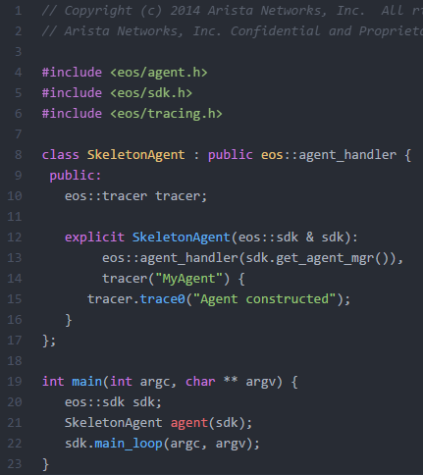
EOSDK Agent Anatomy
Boilerplate -
Including the bare minimum
This agent only derives from agent_handler. There are many others. Ex.
intf_handler: reacts to oper_status, speed changes, etc.
timeout_handler: reacts to a expiring timer
The Constructor: Initializes the tracer and handlers
Main function: Instantiates the agent class and starts the event loop

Slide 20
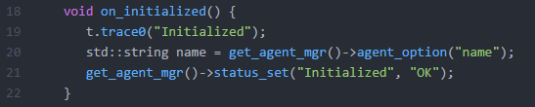
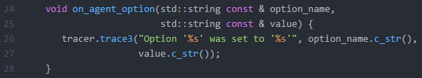

EOSDK: Anatomy (Cont.)
Reacting to events…
Reacting to the initialization event
Reacting to configuration
Reacting to “real” events (note: agent must be extended to derive from eos::intf_handler)

Slide 21
EOSSDK: Hello World
Basic EosSdk agent components
Main agent class
Event loop
Reactor methods… To which events should the agent react?
Examples include: on_timeout, on_intf_status, on_config_option
EosSdk resources:
https://github.com/aristanetworks/EosSdk/wiki

Slide 22
EosSdk: Configuring the demo agent
localhost#configure
localhost(config)#daemon HelloWorld
localhost(config-daemon-HelloWorld)#exec /mnt/flash/HelloWorld
localhost(config-daemon-HelloWorld)#no shutdown
This is an EosSdk application
! No dedicated sysdb profile, using default
localhost(config-daemon-HelloWorld)#show daemon
Agent: HelloWorld (running)
No configuration options stored.
Status:
Data Value
-------------- ---------------------------
greeting Welcome! What is your name?

Slide 23
Debugging and Tracing
In this example:
The tracer is set to monitor all trace levels for the HelloWorld agent
The name “HelloWorldCppAgent” comes from the tracer config inside the agent
“*cf” means monitor levels from 0 to 9
switch(config)#trace HelloWorld setting HelloWorldCppAgent/*cf
switch(config)#end
switch#trace monitor HelloWorld
--- Monitoring /var/log/agents/HelloWorld-18512 ---
===== Output from /mnt/flash/HelloWorld [] (PID=18512) started Oct 11 23:36:17.705501 ===
[AtimeLog] Initially use syscall
2016-10-11 23:36:19.036055 Using external Socket tbl://sysdb/+n
2016-10-11 23:36:19.036172 Using externally set fd: 7
2016-10-11 23:36:19.251405 18512 HelloWorldCppAgent 0 Initialized
2016-10-11 23:42:12.689513 18512 HelloWorldCppAgent 3 Saying hi to Jesse

Slide 24
EOSSDK: Software Defined Routing
Python based controller
C++ Switch agent
Controller uses SPF algorithm to calculate paths through the network
Relies heavily on MPLS nexthop-groups
Can’t demo in vEOS… ☹

Slide 25
Resources
Github Repo: https://github.com/arista-northwest/arista-programmability

